Slide 1
Collect Input in Microsoft Teams with Task Modules

Slide 2
Task Module overview
Invoking task modules
Dismissing task modules

Slide 3
Microsoft Teams Task Modules

Slide 4
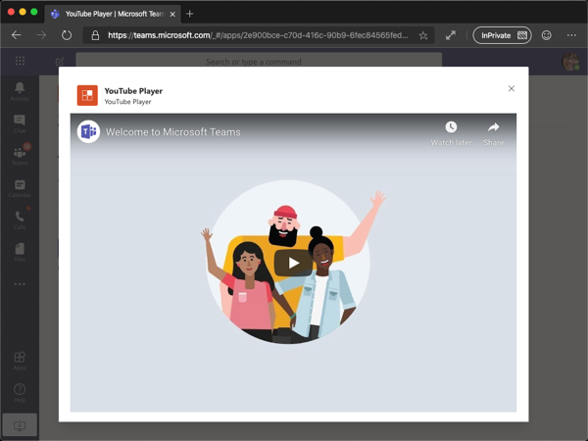
What is a task module?
Modal popup experience within Microsoft Teams
Ideal experience for collection input from a user
Can chain multiple together to create a wizard experience
Built on the foundation of Teams tabs – just a tab in a popup window
Can be implemented as a web page, or Adaptive Card

Slide 5
Task modules structure
App icon
App short name
Task module’s title
Close/cancel button
Entire area available to the web page option
Entire area rendered if using the Adaptive Card option
Adaptive Card button

Slide 6
Invoking task modules
Can be invoked from tabs, bots, or deep links
Each invocation host is slightly different
Invoking from a tab:
Use the Microsoft Teams JavaScript SDK
Invoking from a deep link:
Special URL with task module details in the query string
Invoking from a bot:
Submit special invoke messages

Slide 7
Developing Custom Microsoft Teams Task Modules

Slide 8
Creating task modules as webpages
Task modules can be implemented as a web page
Similar to custom tabs: displayed within an IFRAME
Users can close the task module with the traditional “X” in the upper corner of the IFRAME
Programmatically close / submit the task module using the JavaScript SDK:
dialog.submitTask(returnValue);

Slide 9
Invoking task modules from tabs
Create a TaskModuleTaskInfo object
Specify the details of the task module
Include callback that receives errors or response from task module
Open the task module with the Microsoft Teams JavaScript SDK
dialog.open(taskModuleTaskInfo, callback);
TaskModuleTaskInfo properties:
Properties | Description
title | Appears below the app name and to the right of the app icon
height & width | Number in pixels for the size of task module, or named sizes (small/medium/large)
url | URL of the page loaded as an IFRAME inside the task module (not applicable for Adaptive Cards)
fallbackUrl | If a client doesn't support the task module feature, this URL is opened in a browser tab.

Slide 10
Task module callbacks
When invoking a task module with startTask(), can specify a submitHandler callback
submitHandler(error: string, result: string | any)
Callback receives the result as either a string (from a webpage) or object (webpage / Adaptive Card)
If there was problem invoking the task module, returned as string in error parameter:
Values for both card and url were specified. One or the other, but not both, are allowed
You must specify a value for either card or url
Invalid appId
User cancelled/closed the task module

Slide 11
DEMO
Collecting user input with task modules

Slide 12
Adaptive cards overview
Designing adaptive cards
Invoking task modules using Adaptive cards
Invoking task modules with deep links

Slide 13
Adaptive Cards Overview
Card is a user-interface container for short / related pieces of information
Cards can have multiple properties, attachments and buttons that trigger Card actions
Adaptive cards are a cross product spec for cards in Microsoft products
Microsoft Teams recommends using Adaptive cards for new projects
Simplify creation of UX – focus on the content & functionality, let Teams render it

Slide 14
Developing Adaptive Cards for Microsoft Teams Task Modules

Slide 15
Adaptive Cards as JSON objects
Adaptive cards are represented as a JSON object
JSON defines the controls, text and actions to the hosting application
Hosting application renders the card based on the JSON
Creating the JSON for Adaptive Cards:
Author raw JSON
Create using Microsoft Teams SDK
Create & preview using App Studio

Slide 16
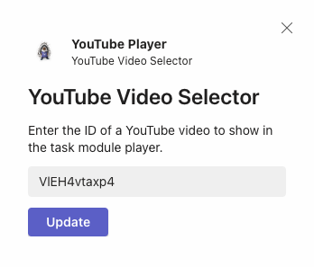
Adaptive Card JSON
{ "type": "AdaptiveCard", "version": "1.0",
"body": [{
"type": "Container",
"items": [{ "type": "TextBlock", "text": "YouTube Video Selector", "weight": "bolder", "size": "extraLarge” }]
},{
"type": "Container",
"items": [
{"type": "TextBlock", "text": "Enter the ID of...", "wrap": true},
{"type": "Input.Text", "id": "youTubeVideoId", "value": ”” }
]
}],
"actions": [{
"type": "Action.Submit", "title": "Update"
}]
}

Slide 17
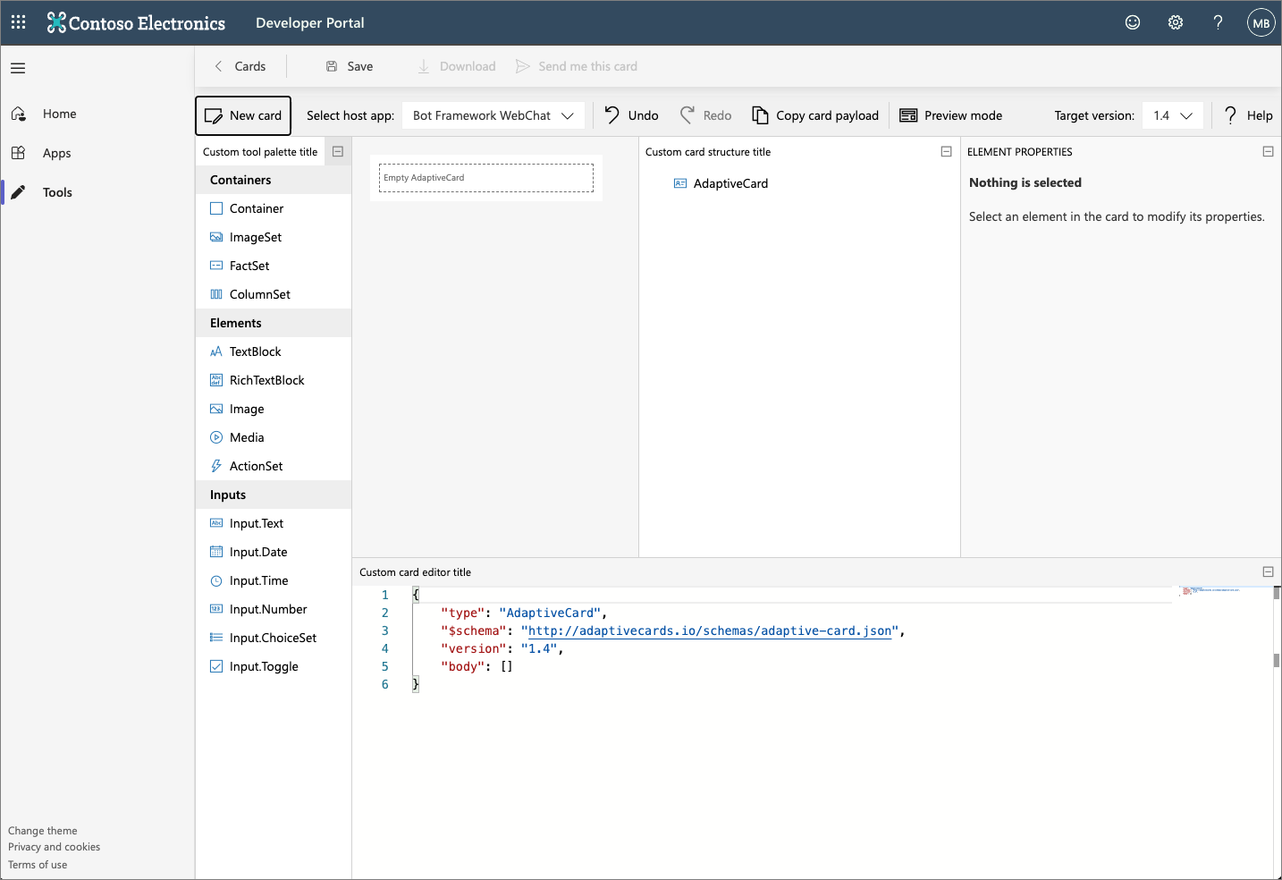
Creating Adaptive Cards with Developer Portal

Slide 18
Using Adaptive Cards with Task Modules
Using Adaptive cards with task modules is similar to using web pages
Task module web pages require setting the the url of the web page
To use an Adaptive cards the card JSON to the card property on the TaskModuleTaskInfo object

Slide 19
Using Adaptive Cards with Task Modules
// load adaptive card
const adaptiveCard: any = require("./YouTubeSelectorCard.json");
const taskModuleInfo = {
title: "YouTube Video Selector",
card: adaptiveCard,
width: 350,
height: 250
};
const submitHandler = (err: string, result: any): void => { };
dialog.open(taskModuleInfo, submitHandler);

Slide 20
Invoke Task Modules using deep links

Slide 21
Invoke task modules with deep links
Task modules can be invoked from tabs, bots and via deep links
Deep link is a special URL that contains the TaskModuleTaskInfo object’s properties encoded in the query string
Can be used to invoke the task module from within Microsoft Teams (conversations, links in tabs, etc) or outside of Microsoft Teams
https://teams.microsoft.com/l/task/<APP_ID>?url=<TASKINFO.URL>&height=<TASKINFO.HEIGHT>&width=<TASKINFO.WIDTH>&title=<TASKINFO.TITLE>
Include the Microsoft Teams’ app’s unique ID in the URL, and all necessary properties for the task module project

Slide 22
DEMO
Using adaptive cards and deep links in task modules

Slide 23
Invoking task modules from bots
Processing task module submissions in bots
Developing bots with task modules

Slide 24
Task Modules & Bots

Slide 25
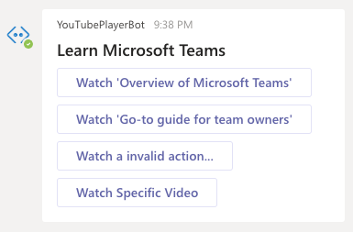
Task Modules & bots
Bots can invoke and process submissions from task modules
Bots differ from tabs and deep links:
There is no user-interface for a user to act on to trigger the opening of a task module
Bots run in a service external to Microsoft Teams
Microsoft’s Bot Framework & the Microsoft Teams SDK have added support for
Invoking task modules
Handling the Action.Submit event where a task module submits information back to the bot

Slide 26
Invoke & Process Task Modules from bots

Slide 27
Invoking Task Modules from bots
Bots can invoke task modules in one of two ways:
Create a deep link and embed it in a message the user can select
Reply/send a special type of message to the Bot Framework & Microsoft Teams
Message details:
type = invoke
value.type = task/fetch or task/submit

Slide 28
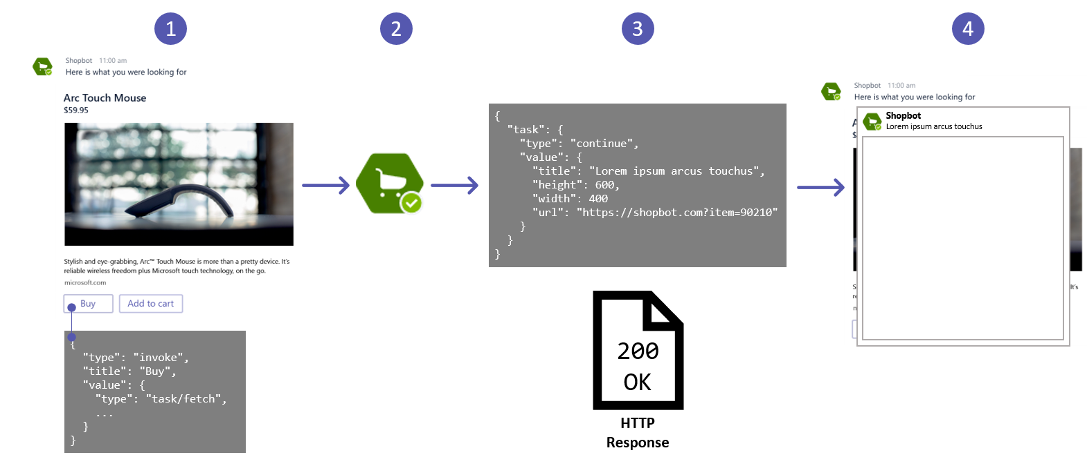
Task Module Invocation from a Bot - How it Works

Slide 29
Handing invoke message types in a bot
Microsoft Teams’ SDK captures and forwards messages to one of two handlers developers can override on the bot class
Messages of type task/fetch processed by handleTeamsTaskModuleFetch()
Called when prompted to display a task module
Messages of type task/submit processed by handleTeamsTaskModuleSubmit()
Called when a task module submits back to it’s caller/host
Similar to submitHandler(error: string, result: object|any) callback in the SDK

Slide 30
Invoke message callbacks responses
Both invoke message handlers return an object of type TaskModuleResponse
Indicates to either display a message or another task module:
Message:
{ "task": { "type": "message", "value": "Message text" } }
Task module:
{ "task": {
"type": "continue",
"value": { "title": <TaskModuleTaskInfo object> }
}
}

Slide 31
DEMO
Using task modules with bots

